Slide 1

0’s | 1’s | 2’s | 3’s | 4’s | 5’s | 6’s | 7’s | 8’s | 9’s
0217 | 1010 | 2121 | 3006 | 4816 | 5262 | 6377 | 7315 | 8272 | 9662
0417 | 1202 | 2266 | 3131 | 4810 | 5557 |  | 7700 | 8738
0424 | 1404 | 2646 | 3284 |  |  |  | 7730
 | 1632 |  | 3395
 | 1696 |  | 3449
 | 1737 |  | 3810
 | 1957

Slide 2
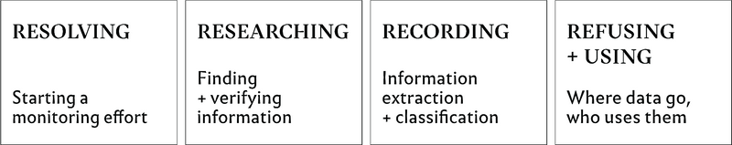

Slide 3




Slide 4
How is the data being collected? Who is being counted? Who is included in the decision-making processes?

Slide 5
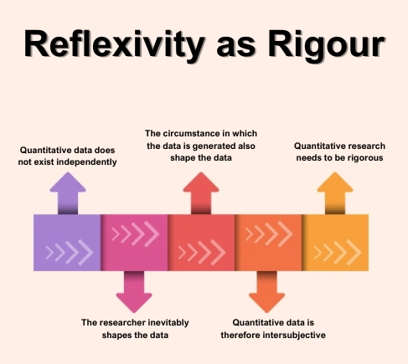

Slide 6

You’re working with a nonprofit organization to design a data collection framework aimed at addressing food insecurity in an urban neighborhood. Your goal is to gather data to better understand the causes, scope, and impact of food insecurity on different populations.

Slide 7
Design Justice Network: “We center the voices of those who are directly impacted by the outcomes of the design process.”

Slide 8
Who are the Stakeholders and Participants?

Slide 9
What data should be collected?

Slide 10
How can the data be collected?

Slide 11
What are some potential impacts and risks?

Slide 12
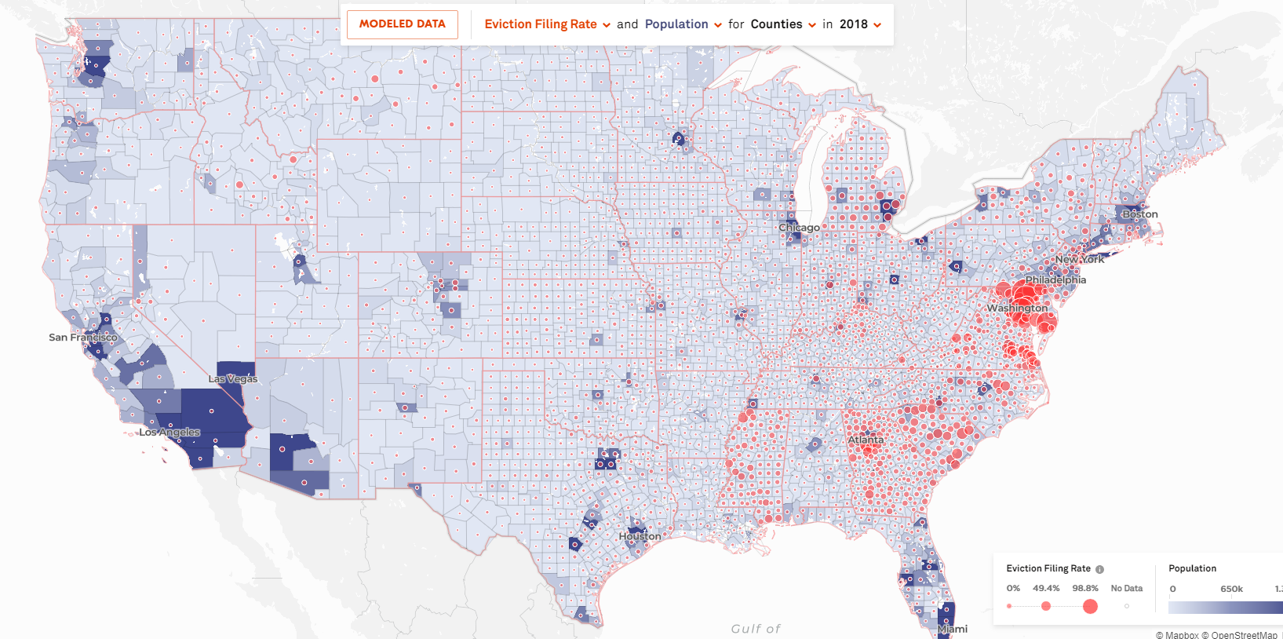
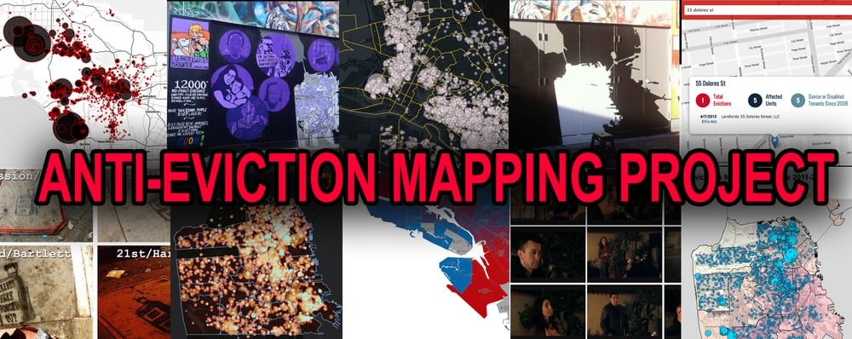

Slide 13

Thursday April 10th @ 4:15 PM
Luke Stark
Assistant Professor in the Faculty of Information & Media Studies (FIMS) at Western University in London, Ontario

Slide 14
Final Project
Proposal
Data Description and Exploration
Comparative Methods Analysis
Final Presentation
Final Paper

Slide 15
Proposal – Due Sunday March 2nd 11:59 PM
Proposal
Data Description and Exploration
Comparative Methods Analysis
Final Presentation
Final Paper
Problem Overview
Data Initiative Overview
Matrix of Domination Analysis
~2 pages (double-spaced)

Slide 16

Without a guiding purpose or problem to address, data collection is merely surveillance.

Slide 17
Data Description and Exploration – Due Sunday March 23rd at 11:59 PM
Data Availability
Data Methodology
Examination of alignment to ethical framework
Optional, coding-based analysis
~3-5 pages (double-spaced)
Proposal
Data Description and Exploration
Comparative Methods Analysis
Final Presentation
Final Paper

Slide 18
Comparative Methods and Analysis – Due Friday April 18th at 11:59 PM
Comparative Review
Ethical Analysis based on framework
Critique
~3-5 pages (double-spaced)
Proposal
Data Description and Exploration
Comparative Methods Analysis
Final Presentation
Final Paper

Slide 19
Final Presentation – April 28th and 30th
Proposal
Data Description and Exploration
Comparative Methods Analysis
Final Presentation
Final Paper
Examine Problem
Examine Data Initiative
Comparison
Summary
~10-12 minutes plus questions

Slide 20
Final Paper
Proposal
Data Description and Exploration
Comparative Methods Analysis
Final Presentation
Final Paper
Introduction
Data and Methods
Comparative Analysis
Discussion
~7-10 pages (double-spaced)

Slide 21
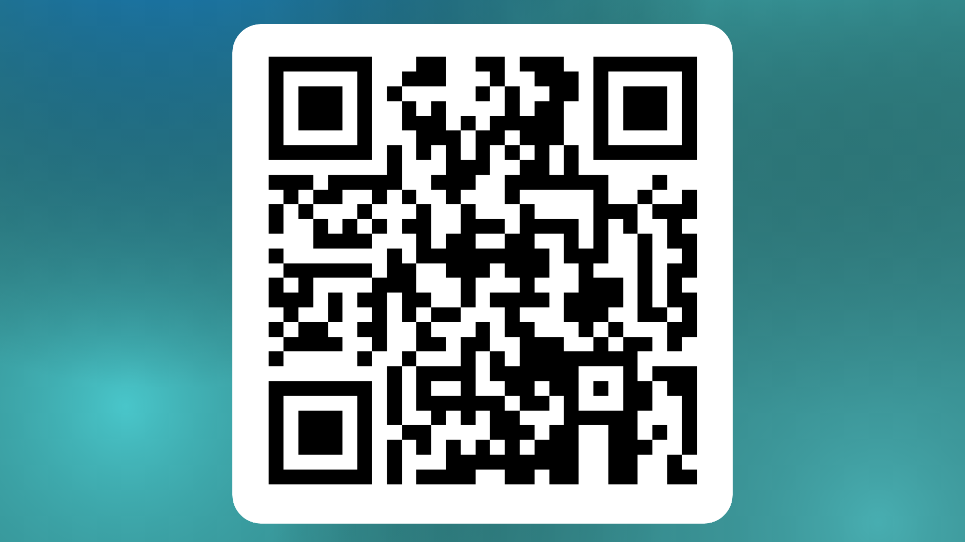

Slide 22
Group 1: Nayera
Members: Jamie, Suzanna, Bianca, Nayera, Nayja
Group 2: Bailey
Members: Bailey, Tess, Jadyn, Valencia
Group 3: Amelie
Members: Everly, Fiona, Yvo, Amelie, Grace
Group 4: Allison
Members: Allison, Caroline, Kripa, Emma, Rebecca
Group 5: Morgan
Members: Amuthini, Anna Nugent, April, Kristen, Morgan
Group 6: Hannah
Members: Shriya, Anna Nguyen, Cynthia, Hannah, Maha

